Slide 1
I Can See Clearly Now
Twilight, Atmospheric Refraction, Seeing, Settings, Transits and All That Stuff

Slide 2
I Love to See That Evening Sun Go Down
Rise, Set, and Twilight Definitions

Slide 3
Sunrise, Sunset
conventionally refer to the times when the upper edge of the disk of the Sun is on the horizon, considered unobstructed relative to the location of interest. Atmospheric conditions are assumed to be average, and the location is in a level region on the Earth's surface.

Slide 4
Tonight’s Sunset
1910 hours EDT
Using TheSky Software

Slide 5
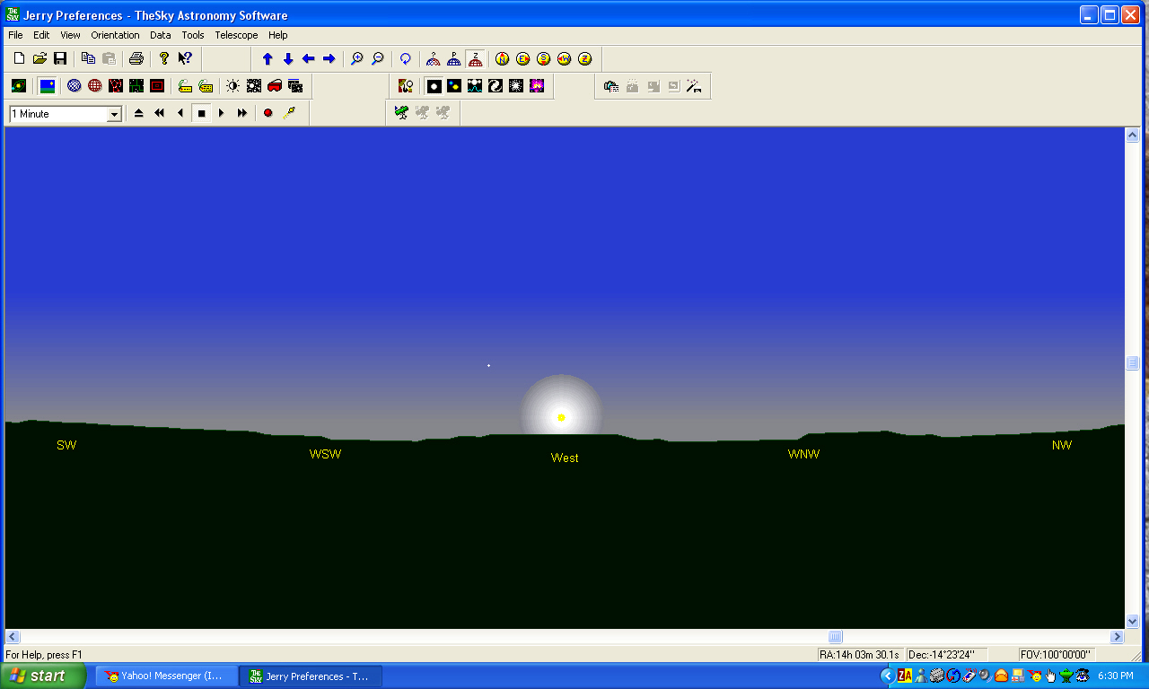
1850 hours EDT, 20 minutes until sunset

Slide 6
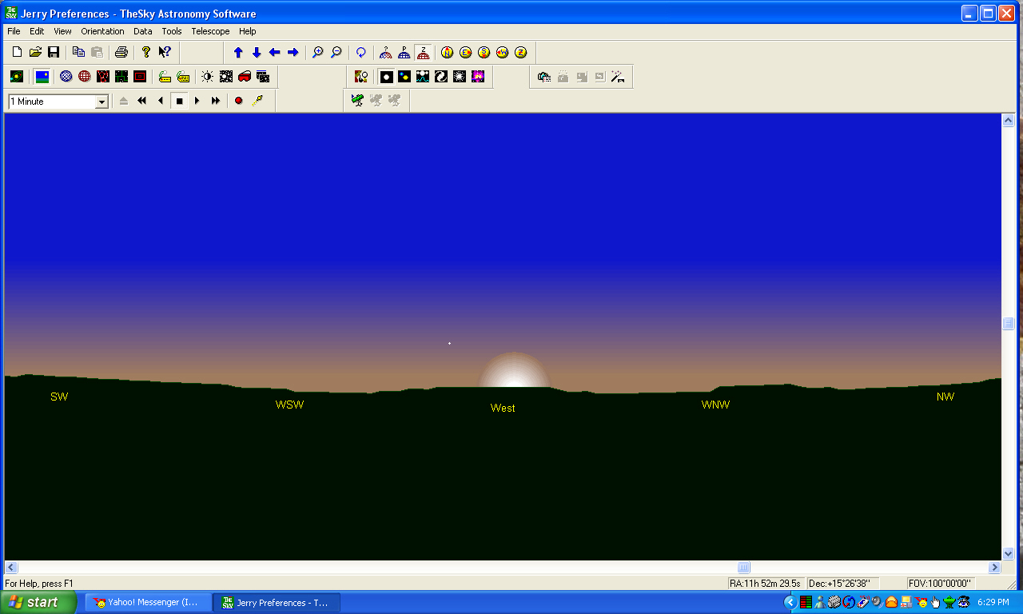
1900 hours EDT, ten minutes until sunset

Slide 7
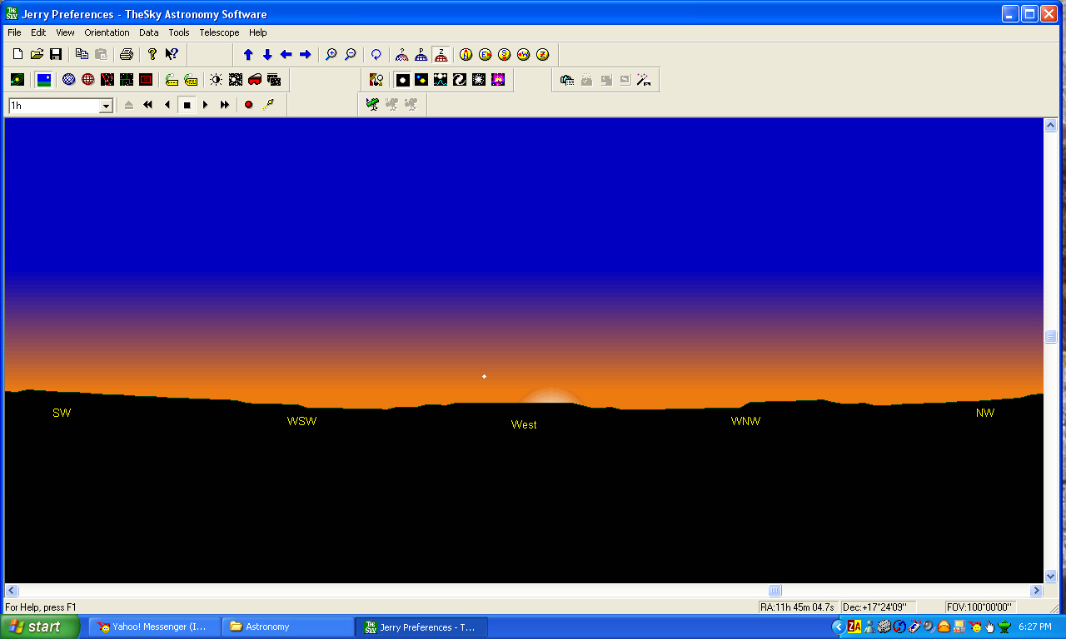
1910 hours EDT, the actual moment of sunset

Slide 8
Moonrise, Moonset
times are computed for exactly the same circumstances as for sunrise and sunset. However, moonrise and moonset may occur at any time during a 24 hour period and, consequently, it is often possible for the Moon to be seen during daylight, and to have moonless nights. It is also possible that a moonrise or moonset does not occur relative to a specific place on a given date.

Slide 9
Tonight’s Moonrise
2339 hours EDT
Using TheSky Software

Slide 10
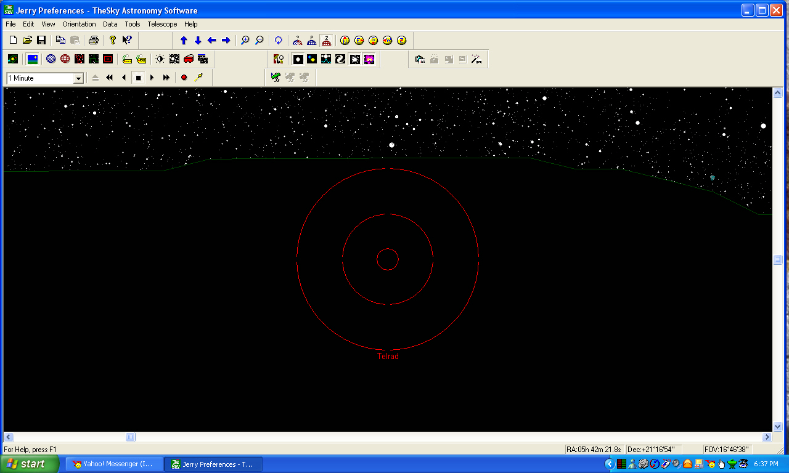
2339 hours EDT, the actual moment of moonrise

Slide 11

2352 hours EDT, 13 minutes after actual moment of moonrise

Slide 12

2355 hours EDT, 16 minutes after the actual moment of moonrise

Slide 13
Aha! You thought you only had sunset and sunrise to worry about, eh? Well, you're wrong. You also have twilight to worry about - and not just one either, there's three of them:

Slide 14
The Twilights
Astronomical - The period of twilight beginning (or ending) when the center of the (refracted) Sun is more than 18° below the horizon. Defined as being 'dark', when serious astronomy can begin and when you can see what you're looking at clearly.

Slide 15
The Twilights
Nautical - The period of twilight beginning (or ending) when the center of the (refracted) Sun is more than 12° below the horizon. Defined traditionally as when you can no longer distinguish the horizon at sea, hence 'nautical'. In perspective, it's about when you can start to see detail in your observations.

Slide 16
The Twilights
Civil - The period of twilight beginning (or ending) when the center of the (refracted) Sun is more than 6° below the horizon. Generally defined as when you can still read a newspaper unaided, but as usual this varies from person to person. From an astronomer's point of view, this is about when the bright stars begin to appear

Slide 17
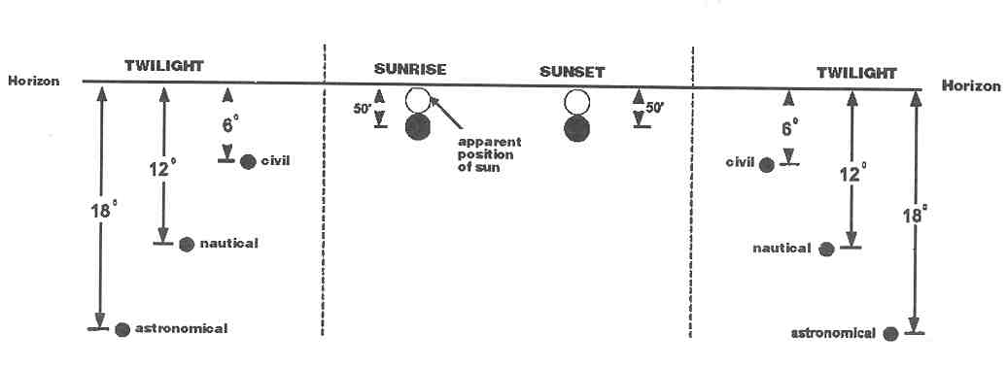

Slide 18
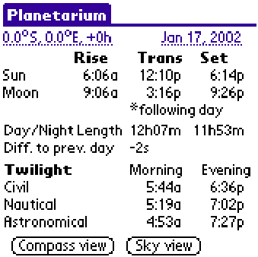

Slide 19
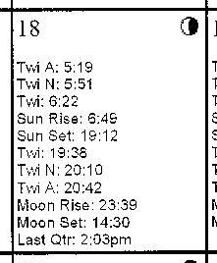

Slide 20
Night Hours: The night is the astronomer's day
astronomical night hours: from the end of astron. twilight to the beginning of astron. twilight next day, The Sun is 18° below the horizon.

Slide 21
Clouds
In My Coffee

Slide 22
Cloudy Issues
Clear Sky Clock cloud forecast images are produced ONLY TWICE A DAY.
You cannot interpret cloud heights or cloud types with these images unless you are an expert.
The only information available is the cloud cover forecast for the next 48 hours.

Slide 23
More Cloudy Issues
The models do a good job on cirrus (thin high clouds).
They overforecast cloud cover.
You have to distinguish between cloud cover and opacity.

Slide 24
Sky Transparency
For astronomical purposes

Slide 25
Seeing
But not as in clairvoyance
Notes:
What is Seeing
Seeing is the term astronomers use to describe an image formed by a telescope that is jiggling, wiggling, swarming, blobbing or otherwise moving in a manner that destroys visible detail. It's really quite annoying.
The cause is a combination of temperature difference and turbulence in the atmosphere that the light travelled to get to the eyepiece. That means it can be anywhere from the high atmosphere to the air in the telescope.
Bad seeing caused by temperature and turbulence in a telescope tube is properly called tube currents. Bad seeing caused by local effects, like a hot driveway, is properly called ground seeing. Bad seeing caused by temperature and turbulence in the atmosphere, for example the jet stream, is properly called atmospheric seeing. But astronomers tend to use the term seeing to mean just the appearance of bad seeing.
This website prefers to use seeing to mean atmospheric seeing.
A night of exceptionally good seeing, a night where the detail seen on Jupiter causes observers to swoon and swear, is thought to be rare. It would be boon to know in advance when good and bad seeing might occur.

Slide 26
The Clear Sky Clock Parameters
Cloud Cover is visible-light cloud forecast. It forecasts percentage cloud cover.
Notes:
Amateur and professional astronomers are always confronted by sky conditions when they observe during the night. In the preparation of your observation session, you can take advantage of the cloud forecast of the Canadian Meteorological Centre GEM Regional model. Interpret these images the same way you would for GOES visible satellite pictures found on various web sites.
These images show the fraction of the sky covered by clouds on a scale of 10. The chosen colour panel allows easy interpretation as clouds are white and clear skies dark blue.
The white areas represent overcast skies.
Light blue or indigo colour areas are partially covered skies.
Dark blue zones are clear skies.
You cannot interpret cloud heights or cloud types with these images, unless you are an expert The only information available is the cloud cover forecast for the next 48 hours.
Some hints.
1- Cirrus (thin high clouds).
Numerical weather models do a good job of forecasting cirrus ahead of major weather systems. But, they often overforecast cloud cover. Here we have to distinguish between opacity and cloud cover. The sky could be covered with 9/10 of cirrus but thin enough with only 3/10 of opacity. In other word, despite a nearly full sky coverage, the clouds are so thin that stars are blocked in only 3/10 of the sky. This means that the model cloud cover forecast may look excessive in some cases. Finally we should remember that cirrus isn't very good for deep sky observations but could be helpful for planetary observations.
2- Thunderstorms
Thunderstorms are local phenomena whose dimensions and structures fall below those resolved by weather models. This becomes a problem in warm seasons. Sometimes, they are underforecast and other times overforecast. Thunderstorm development takes large vertical proportions and the cloud tops can be displaced over long distances if they interract with jet streams. Due to the temporal and spatial uncertainty of thunderstorm development in the weather models, the cloud shield can easily end up farther north or south than forecast. So, be careful in using these images in the warm season.

Slide 27
The Clear Sky Clock Parameters
Transparency the total transparency of the atmosphere from ground to space. It's calculated from the total amount of water vapor in the air.
Notes:
Sky transparency forecast for astronomical purposes.
Observing deep sky objects such as faint galaxies and nebulae requires excellent sky transparency. Astronomers evaluate sky transparency with the faintest star visible to the unaided eye. In semi-desertic regions such as Arizona, one can see stars as faint as 6.5-7.0 magnitude. At mid-latitudes and in the more humid eastern regions, sky transparency is limited to the 4.5-6.0 range in the countryside. Sky transparency also varies with airmass type. With a humid airmass the transparency is reduced significantly. With a continental airmass from the arctic, relatively cold and dry conditions prevail, allowing the sky transparency to be at times be as good as in the semi-desertic regions. Good forecasts of such rare starry evenings will clearly be useful to the amateur astronomer.
The goal of this new product is to inform you about expected sky transparency conditions in your region.
The following images are sky transparency forecasts for North America. Moisture is the only element affecting sky transparency which can be both measured and forecast all across the globe. It is often the most important factor in reducing sky transparency. A muggy summer day with a whitish sky is the best example of this moisture effect.
Industrial pollutants and light pollution affect the sky transparency as well, but only locally. Aerosols such as volcanic ash, pollen, sea salt and smoke from forest fires also contribute to reduced sky transparency. The same can be said for auroras. None of these factors is integrated into our transparency forecast images.
So the experimental forecast is only an integration of moisture throughout the air column with a distribution emphasizing the humidity near the surface and near the tropopause. The quality of the sky transparency is represented by 4 colour levels. The darkest shade of blue represents the best sky transparency. The white zones are areas where the weather models forecast clouds.
Dark blue........... excellent sky transparency.
Medium blue ... above average sky transparency.
Light blue.......... average sky transparency.
Pale blue........... poor sky transparency.
White.................. cloudy sky.

Slide 28
The Clear Sky Clock Parameters
Seeing is the astronomical seeing forecast. This is an experimental forecast.
Excellent seeing means at high magnification you will see fine detail on planets and stars will show diffraction rings.
In bad seeing, planets might look like they are under a layer of rippling water and show little detail at any magnification, but the view of galaxies is will probably be undiminished.
Bad seeing is caused by turbulence combined with temperature differences in the atmosphere.
This forecast attempts to predict turbulence and temperature differences that affect seeing for all altitudes.
Notes:
Observing planets, planetary nebulae or any celestial object with details at high power requires excellent seeing conditions. The seeing is the term used in astronomy to quantify the steadiness or the turbulence of the atmosphere. Seeing should not be confused with sky transparency, which is the terminology used to qualify the darkness of the sky. When we look at planets, we need high power to see all the fine details but most of the time we are limited by turbulence occurring in the telescope (local seeing) and/or in the atmosphere. During a night of bad seeing we are usually limited to see only two bands on the Jupiter disc and we can hardly use power over 100-150x. On excellent seeing conditions we can use high power and see many bands, white spots, festoons and details in the great red spot. Excellent seeing with high quality telescopes can also show details on the largest moon of Jupiter, Ganymede. What we are seeking is the best nights where we can boost our telescopes to their limits… which reach as high as 50X per inch diameter for quality telescopes… which means 500x for a quality 10-inch ( 25cm ) instrument.

Slide 29

V ….. Perfect motionless diffraction pattern.
IV….. Light undulations across diffraction rings.
III….. Central disc deformations. Broken diffraction rings.
II…… Important eddy streams in the central disc. Missing or partly missing diffraction rings.
I……. Boiling image without any sign of diffraction pattern.
V..................... < 0.4"
IV.................... ~ 0.4-0.9"
III.................... ~ 1.0-2.0"
II..................... ~ 3.0-4.0"
I...................... > 4"
Notes:
Professional astronomers and more advanced astro-amateurs evaluate the seeing with a scale 1-10. Through a telescope, they measure the star diameter which usually ranges from bad seeing at 5-8 arcsec to excellent seeing at 0.5-0.2 arcsec. Astro-amateurs, can also use a qualitative way to measure the seeing. They look through their telescope at the zenith for a 2-3 magnitude star at about 30-40X per inch diameter ( 300-400x for a 10 inch telescope ) and from the look of the diffraction pattern they estimate the seeing on a scale I-V.
Of course, the diffraction pattern diameter is related to the aperture of the telescope. The diffraction pattern of a 4 inch telescope is twice as large as for an 8 inch instrument. So the seeing rating with this method will depend of the diameter of the telescope. An astro-amateur rating the seeing at 4/5 with a 6 inch telescope will certainly appear as a 3/5 with a 12-14 inch optical instrument. So it is important to understand or be aware of this difference. This forecast is based on the data accumulated with 11-14 inch telescopes during a four year period, so this study was done with the average modern astro-amateur telescope diameter. Astro-amateurs owning a smaller telescope may find the following forecast a bit pessimistic but you can adjust the colour index to your observations. Amateurs owning an 8-20 inch telescope should find this product quite useful and when the forecast shows a seeing 5/5 over an area… it should be the best planetary conditions for any telescope diameter.

Slide 30
The Clear Sky Clock Parameters
Darkness is not a weather forecast. It shows when the sky will be dark, assuming no light pollution and a clear sky.

